Slide 1

Generating Permutations Using Decrease And Conquer
Mohnad Ahmed
223933

Slide 2
Table of Contents - Problem Definition - Strategy - Algorithm - Implementation - Analysis - Conclusion

Slide 3
Problem Definition
Generating Permutations:
Generating permutations refers to the process of systematically listing all possible arrangements of a set of elements in a specific order without repetition.
In Our Problem, We want to generate all possible arrangements for numbers from 123…N
Example N = 2
Result = [{1,2},{2,1}]
Example N = 3
Result = [{1,2,3},{1,3,2},{3,1,2},{3,2,1},{2,3,1},{2,1,3}]

Slide 4
Strategy
Decrease And Conquer
Decrease and conquer is a technique used to solve problems by reducing the size of the input data at each step of the solution process.
The technique is used when it’s easier to solve a smaller version of the problem, and the solution to the smaller problem can be used to find the solution to the original problem.

Slide 5
Algorithm
Decrease By One
If n = 1 return 1; otherwise, generate recursively the list of all permutations of 12… n-1 and then insert n into each of those permutations by starting with inserting n into 12... n-1 by moving right to left

Slide 6
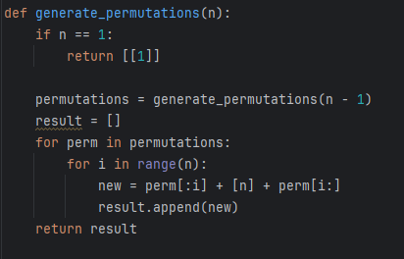
Implementation
Example n = 2
Decrease problem size by 1 until becomes 1
Return [[1]]
Recursively:
Permutations = [[1]]
Range [n] = [0,1]
i = 0 , result [[1,2]]
i = 1 , result [[2,1],[1,2]]

Slide 7
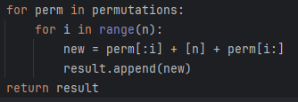
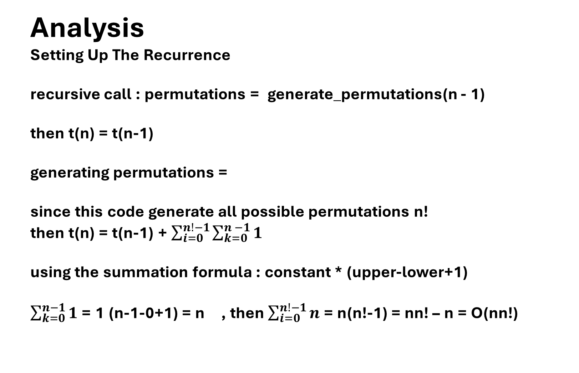
Analysis Setting Up The Recurrence recursive call : permutations = generate_permutations(n - 1) then t(n) = t(n-1) generating permutations = since this code generate all possible permutations n! then t(n) = t(n-1) + $\sum_{i=0}^{n!−1}{\sum_{k=0}^{n −1}{1}}$ using the summation formula : constant * (upper-lower+1) $\sum_{k=0}^{n−1}{1}$ = 1 (n-1-0+1) = n , then $\sum_{i=0}^{n!−1}{n}$ = n(n!-1) = nn! – n = O(nn!)

Slide 8
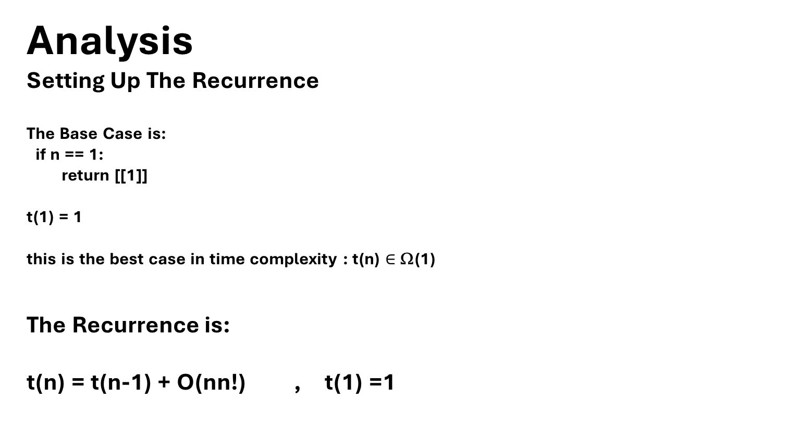
Analysis Setting Up The Recurrence The Base Case is: if n == 1: return [[1]] t(1) = 1 this is the best case in time complexity : t(n) $∈$ Ω(1) The Recurrence is: t(n) = t(n-1) + O(nn!) , t(1) =1

Slide 9

Analysis Solving the recurrence : t(1) =1 t(n) = t(n-1) + O(nn!) substitute until reaching a pattern (t(1) = 1 , k = n-1) t(n) = t(n-k) + O(nn!) t(n) $∈$ O(nn!) (worst case)

Slide 10
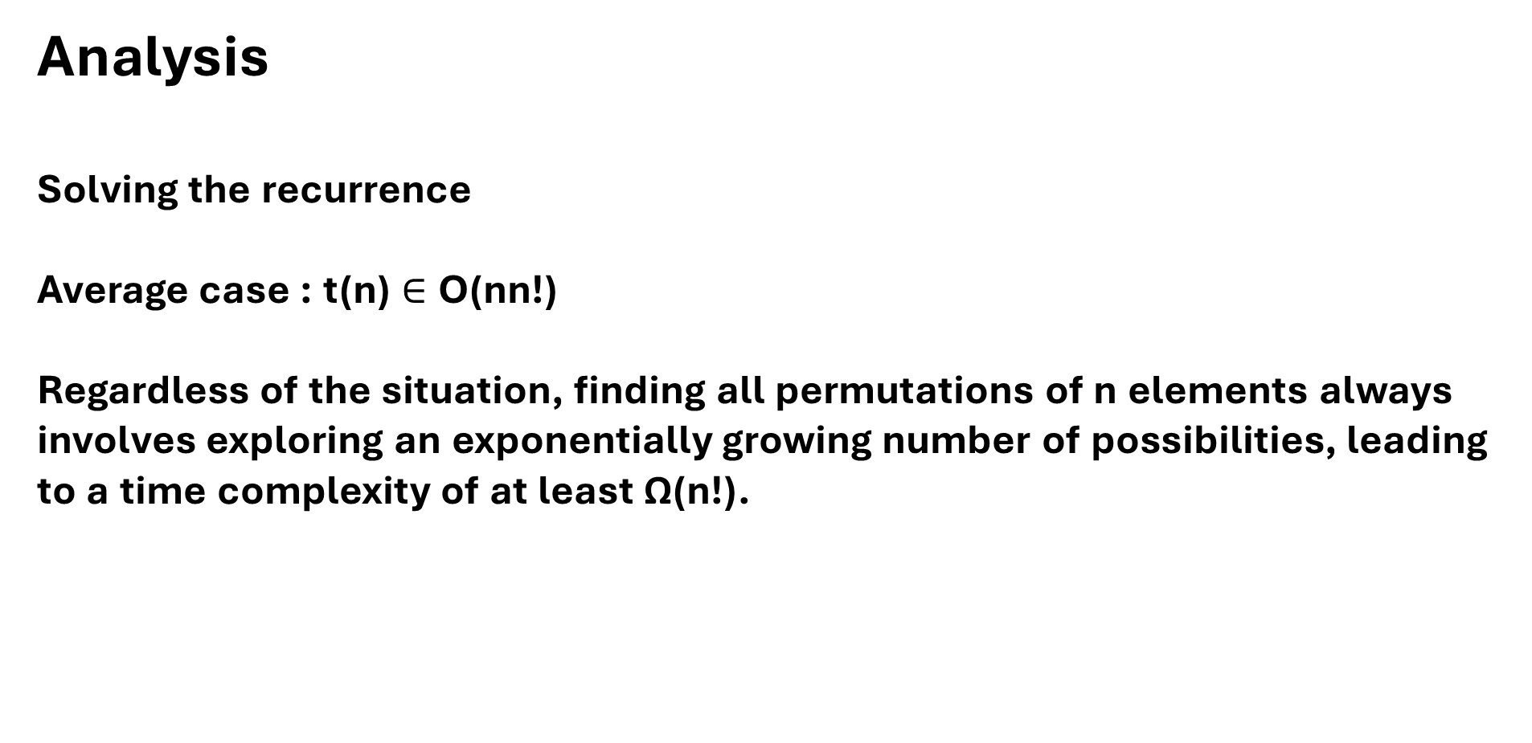
Analysis Solving the recurrence Average case : t(n) $∈$ O(nn!) Regardless of the situation, finding all permutations of n elements always involves exploring an exponentially growing number of possibilities, leading to a time complexity of at least Ω(n!).

Slide 11
Conclusion In summary, employing the 'Decrease and Conquer' technique for generating permutations effectively breaks down the problem into smaller subproblems, solving them recursively. However, due to the exponential nature of permutations, the time complexity remains Ω(n!), where 'n' represents the number of elements. Regardless of the scenario, be it the average, or worst case, the fundamental requirement to explore the entire set of arrangements leads to this exponential time complexity.

Slide 12
Thank You
mohnad.ahmed@msa.edu.eg

